Slide 1

Warehouse Management System (Final Presentation)
Lucky Guys (LG)
Team 2 27/June/2014
Document ID : [WMS_Presentation_002]
Notes:
첫 페이지 – 인사용
오늘 원래 이 야경을 보았어야 했는데 식당이 바뀌어 아쉽다.
피츠버그의 아름다운 야경을 공유하기 위하여 표지를 바꿔보았다.

Slide 2
Contents
Project Overview
1.1. Project Goal
1.2. System Context & Scope
Project Management
2.1. Time Logging & Result
2.2. Gap analysis Earned Value Analysis
Architectural Drivers
3.1. Earned Value Analysis
3.2. Gap analysis of the Earned Value chart
Key Decision & Rational
4.1. How we select architecture
4.2. Strategy & Tactics for meet QA
Artifacts
Lesson Learned
Q&A

Slide 3








Team Organization
Team Name: Lucky Guys
Mentor
Role | Assign
Project Manager | Hyungsun Kim
Architect | Jaean Yi
Test Manager | Jonggon Kim
Package Manager | Kideok Kim
Protocol Manager | Dongju Kim
Documentation Manager | Heeseung Kim
Time Log Manager | Hyugjin Kwon
Clifford Huff
Project Management
Hyungsun Kim
Architect
Jaean Yi
Arduino Development
Kideok Kim, Jonggon Kim
Server Development
Dongju Kim, Heeseung Kim
UI Development
Hyeongjin Kwon

Slide 4
Project Overview
Overview
Customer is Willy’s Widget Company (WWC)
WWC wants an integrated customer order and semi-automated warehouse system
System must take orders from customers, fill the orders, and move them to the shipping center for packing and shipping
Notes:
이전과 동일하므로 설명하지 않고 넘어감

Slide 5
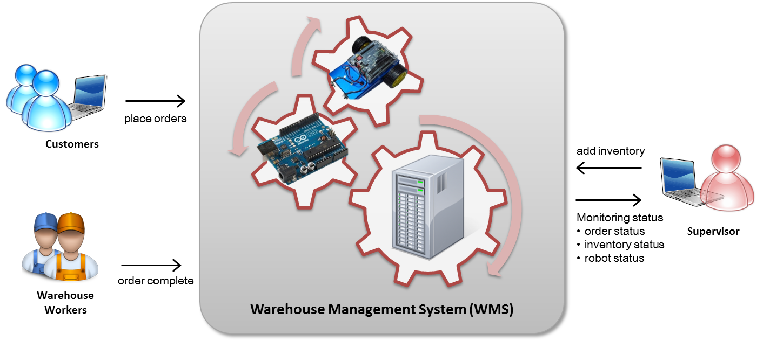
System Context & Scope
Development Scope | Description
Customer User Interface | User Interface for customer’s order
Supervisor User Interface | User Interface for supervisor to manage and to monitor system
Warehouse Manager | Warehouse management server
Robot Control Program | Robot control module
Warehouse Controller Program | Warehouse controller managing module
Notes:
Context는 이전과 동일하며 프로젝트의 Scope를 명확하게 기술하였음

Slide 6
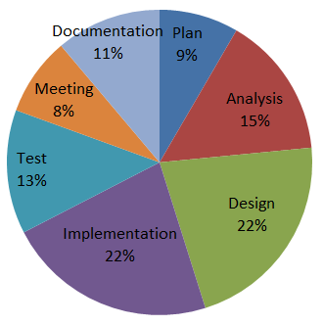
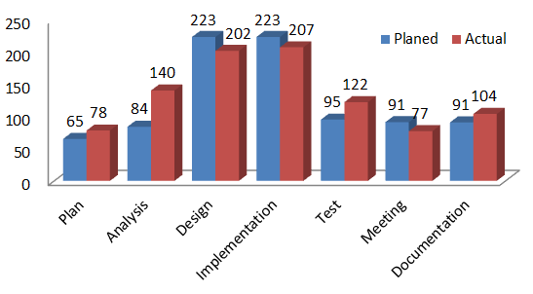
Project Management – Time Logging & Result
Using web base Individual time log (google Doc)
Task ID | Task | StartTime | EndTime | UsedTime | Comments
2.4 | Project Stretegy Decision | 5/13/2014 18:10:00 | 5/13/2014 18:30:00 | 0:20:00 | Discuss Initial Presentation outline
2.1 | Functional Requirement Analysis | 5/13/2014 18:30:00 | 5/13/2014 21:30:00 | 3:00:00 | Problem domain study, Correct functional requirement
2.2 | Architecture Driver | 5/14/2014 18:30:00 | 5/14/2014 20:30:00 | 2:00:00 | Context analysis, Quality attributes items analysis
Result of time Log
Time Spent (%)
Time Spent (Hour)
Notes:
타임 로그의 결과를 그래프로 표현하여 간단하게 설명 필요

Slide 7
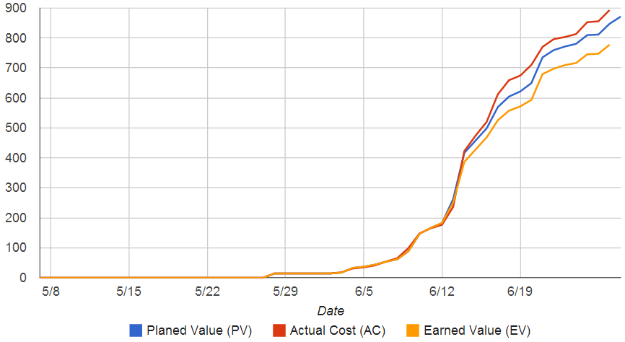
Project Management – Earned Value Analysis
Expected Working Hour : 735 Hrs.
(7Day * 3 Hour * 7Man * 5 Week)
❸
Over Plan
❷ GAP▲
Working Hard
but, Performance..
❶ Unrealistic Plan
& Working Hard
Gap analysis of the Earned Value chart (Implications)
❶ Plan was unrealistic. We worked very hard to meet the plan.
❷ GAP: Performance was less than desired because of reading assignment load.
❸ Over planned and over worked compared to original plan.
Notes:
Earned Value Analysis 중 일부 내용만 소개

Slide 8
Architectural Drivers
Quality Attributes
Refine 5 Quality Attributes about Availability
Prioritization by QA utility tree
Gathering Top 3 Significant QA
High Level Functional Requirement
26 FR collected
Constraints
5 Business constraints
10 Technological constraints
Notes:
초기에 비하여 5개의 QA를 프로젝트 진행 동안 Refine 하였다
Quality Attribute Utility Tree를 이용하여 QA중 우선적으로 중요하게 수행해야 하는 속성을 찾아 내었음

Slide 9
Quality Attributes
Using quality attribute utility tree for prioritization
QA ID | QA Type | Description | P | D
QA-01 | Modifiability | Warehouse management system can be enlarged in physically | M | M
QA-02 | Modifiability | Fulfilling an order which Robot cannot handle at once. | L | L
QA-03 | Availability | If robot's IR sensor was broken, error status can be monitored in management system | M | M
QA-04 | Availability | Loss of WIFI Communication between robot and server can be detected and recovered in time | H | M
QA-05 | Performance | The system should able to complete within a required time from customer order | L | M
QA-06 | Availability | Loss of WIFI Communication between server and warehouse controller can be detected and recovered in time | H | M
QA-07 | Availability | If robot’s don’t move because of battery is too low, robot status can be monitored in management system | L | H
QA-08 | Availability | If server does not response, warehouse controller can be detected and try to reconnect. | H | M
QA-09 | Availability | If robot does not respond to command, system detects error and recover in time. | H | M
QA-10 | Security | Unauthorized Supervisor accesses should not be allowed. | L | H
Priority (P) | Priority Value
H | Must Have
M | Nice to Have
L | If There’s Time
Difficulty (D) | Description
H | High complexity and large amount of effort required
M | High complexity or large amount of effort required
L | Moderate complexity and medium amount of effort required
Notes:
초기에 비하여 5개의 QA를 프로젝트 진행 동안 Refine 하였다
Quality Attribute Utility Tree를 이용하여 QA중 우선적으로 중요하게 수행해야 하는 속성을 찾아 내었음

Slide 10
Architectural Drivers - Quality Attributes
Significant Quality Attributes
QA ID | QA Type | Significant Top 3 Quality Attributes | Priority | Difficulty
QA-04 | Availability | Loss of WIFI Communication between robot and server can be detected and recovered in time | H | M
QA-06 | Availability | Loss of WIFI Communication between server and warehouse controller can be detected and recovered in time | H | M
QA-08 | Availability | If server does not response, warehouse controller can be detected and try to reconnect. | H | M
Notes:
Customer의 관심이 Availability에 있기 때문에

Slide 11
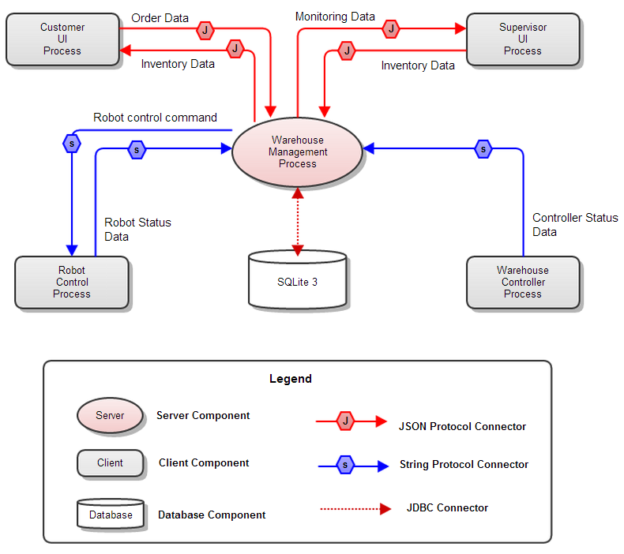
Key Design Decision : Select architecture pattern
Notes:
Customer의 관심이 Availability에 있기 때문에

Slide 12
Key Design Decision & Rationales
Whole Decision and Rationales are described in [WMS_Desing_002] Doc
No | Rationales & Tradeoff | Promoted Quality Attribute
1 | Using ‘Client-Server’ Architecture pattern | Scalability
2 | Using database | Scalability
3 | Selecting protocol | Interoperability
4 | Why WIFI is used for network between warehouse controller and server | Modifiability
5 | How do we find server address | Usability
6 | Using Ping-Echo Mechanism | Availability
7 | Using CRC(cyclic redundancy check) for packet error handling | Availability
8 | Using multi thread in server | Scalability
9 | Using shared memory connection (for Inter Thread Communication) | Performance
10 | Using MVC patterns in UI application | Modifiability
11 | Robot moves one-way only | Scalability
12 | Using manual command mode in bot control | Availability
Notes:
총 12개의 시스템 설계시 선택 사항에 대하여 도출하였다.
상세 내용은 WMS_Design_002 문서에 기술되어 있다.
프리젠테이션 시간이 짧은 관계로 가장 핵심적인 선택사항에 대한 근거와 문제점, 문제점 극복을 위한 전략을 소개한다.

Slide 13
What we explain …
Goal of this section
We discuss about architecture selection
How we select notional architecture
Why we change the system architecture
Weakness of changed architecture
Our strategy for meet Quality Attributes
Using tactics for Quality Attributes
Result architecture

Slide 14
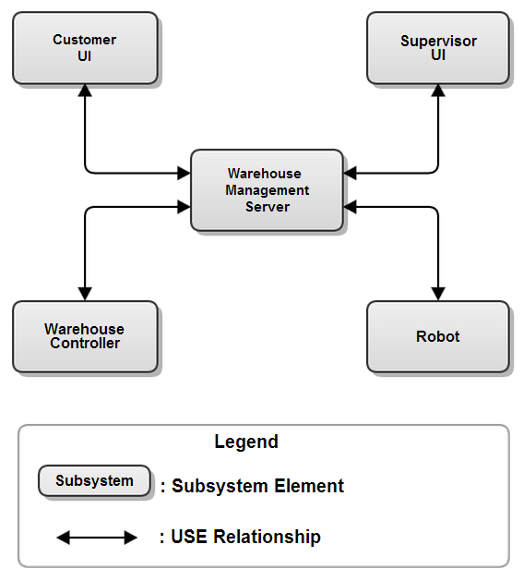
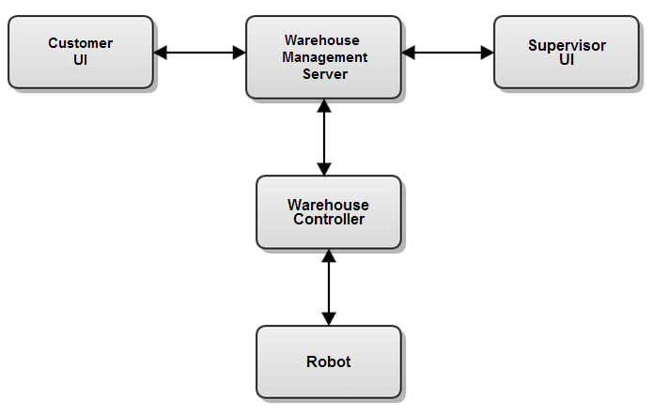
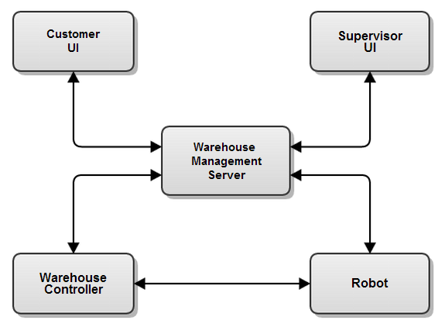
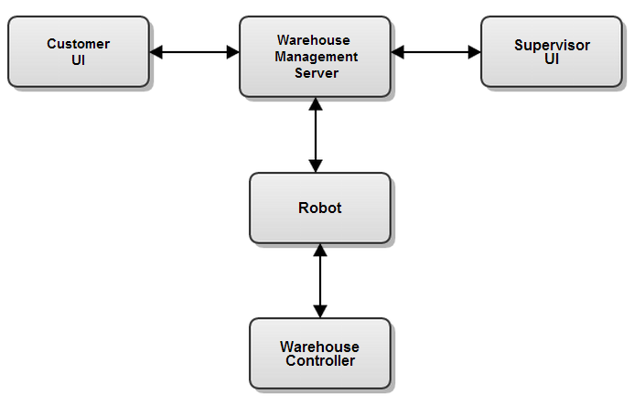
Candidate Notional Architectures
Current
Archtiecture
1St Selected
#1. Client – Server Architecture
#2. Controller mediate Architecture
#3. Robot mediate Architecture
#4. All connected Architecture
Notes:
4개의 아키텍처 후보군이 있었고, QA Evaluation을 통하여 Notional Architecture를 선택 하였다.

Slide 15
Notional Architecture Select by QA Evaluation
Notional Architecture Select by using QA Score
ID | QA Category | Description | Priority Score | #1 Centralized | #2 Server – Controller | #3 Server - Robot | #4 All Connected
QA-01 | Modifiability | Warehouse management system can be enlarged in physically | 3 | MID(3) | HIGH(5) | LOW(1) | LOW(1)
QA-02 | Modifiability | Fulfilling an order which Robot cannot handle at once | 2 | HIGH(5) | HIGH(5) | HIGH(5) | HIGH(5)
QA-03 | Availability | If robot's IR sensor was broken, error status can be monitored in management system | 4 | HIGH(5) | HIGH(5) | HIGH(5) | HIGH(5)
QA-04 | Availability | Loss of WIFI Communication between robot and warehouse | 5 | HIGH(5) | MID(3) | MID(3) | HIGH(5)
QA-05 | Performance | The system should able to complete within a required time from customer order | 1 | MID(3) | HIGH(5) | HIGH(5) | MID(3)
Total Score (Priority Score * Point Score) |  |  |  | 67 | 65 | 53 | 61
Notes:
최초 아키텍처 선정을 위한 과정
당시 가지고 있던 QA를 기반으로 각 후보 아키텍처에 대하여 평가하고 선정하였다.
총 4개의 후보 아키텍처가 있었음 (혹시 요청하면 Appendix에 ..)

Slide 16
1st Notional Architecture
1st Selected Notional Architecture
We try experimentation to check warehouse controller’s performance
:: Role ::
Need to handle robot status
Server role for robot
Client role for Manager Server
:: Experimentation ::
1) Test server protocol (PASS)
2) Test robot protocol (PASS)
3) Simultaneously test 1&2 (Fail)
Notes:
서버와 클라이언트의 역할을 동시에 수행해야 함
서버역할 프로토콜 처리 : 통과

Slide 17
Result of 1st Notional Architecture Experimentation
Pre-Experiment
Experiment Title : Warehouse controller handle many socket | Experiment ID : EXP-001
Issue ID/Description : Warehouse controller network ability is not clear | Responsible Engineer : Jonggon Kim
Issue Deposition : Experimentation required.
Purpose The purpose of the experiment is to clarify the Arduino Socket limitation
Description of the Experiment : In Arduino homepage, All examples of Wi-Fi communication use only one socket. To connect with a lot of robots, the warehouse controller shall maintain multiple sockets at the same time. We should verify whether warehouse controller can use multiple sockets simultaneously.
Post-Experiment (Result : FAIL)
Summary of the Findings : Multiple sockets in Arduino can’t used simultaneously at our experiment. Also, too much time is required when dynamic socket connection/disconnection handling is used step by step with only one socket. In our experiment result, at least 4 seconds are required when two remote sockets connect and transfer data sequentially. To use multiple sockets, the time is lack to perform necessary logic in Arduino.
Responsible Engineer’s Recommendations : There are problem that warehouse controller shall be not acting as intermediate role between Warehouse Management Server and robot because multiple sockets are not supported simultaneously. It takes too much time when only one socket is used step by step and it has difficult to perform necessary function with this only socket. So, an alternative architecture shall be required. This alternative architecture shall focus on reducing role of warehouse controller.
Notes:
Customer의 관심이 Availability에 있기 때문에

Slide 18
Select 2nd Notional Architecture
2nd Architecture use “Client-Server Architecture Pattern”
Notes:
2번째 후보인 아키텍처를 선택 – C-S 형태임
C-S는 근본적으로 가지고 있는 약점이 있음

Slide 19
Trade-Off Analysis of Client-Server patterns
Promoted Quality Attributes
Scalability : System can add more clients easily and manage various kinds of data systematically.
Inhibited Quality Attributes
Reliability : Whole system should be stopped when server does not work properly
Complexity : Server program becomes complex because server should handle various requests from clients.
Design Decision | Using Client-Server Architecture Pattern
Reason | We found warehouse controller does not have multiple socket connection capability after experiments
Promoted Quality Attributes | Scalability (attach more clients)
Trade-Off | Increased server program complexity All subsystem should be connected to same network area Server can be a single point of failure
Notes:
Customer의 관심이 Availability에 있기 때문에 우선순위가 높지만
C-S 방식은 Availability에 약점이 있음

Slide 20
Strategy
One of weakness of Client-Server architecture
It is not necessarily highly Available
➔ Our Strategy is to improve availability by using tactics & algorithms
Next two slide explains how we try to meet this significant QA
Using tactics for improving availability
Availability is significant Quality Attribute in WMS project
QA-IDx | QA type | Description
QA-04 | Availability | Loss of WIFI Communication between server and robot can be detected and recovered in time
QA-06 | Availability | Loss of WIFI Communication between server and warehouse controller can be detected and recovered in time
QA-08 | Availability | If server does not response, warehouse controller can be detected and try to reconnect

Slide 21
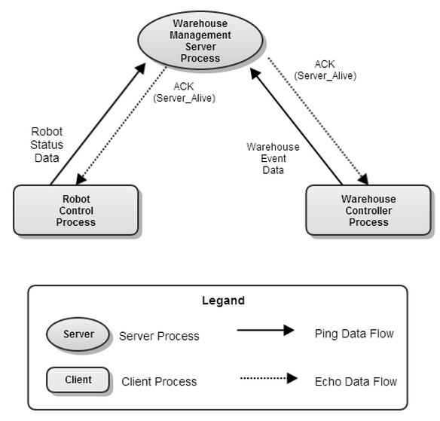
Using Tactics For Availability
Using Ping-Echo Tactics
Significant QA (Availability) are related to network connection failure
Can detect Failure?
Element | Reactions in failure status
Robot Control Process | 1) Maximum waiting time for server response is 3 second 2) Message re-sending in case of no ACK 3) Re-connect to server through WIFI in case of no response after 3 times message delivering 4) Client re-boot when not connected in 3 minutes
Warehouse Controller Process
Notes:
약점을 완화하기 위하여 Ping-Echo 전략을 활용
Ping-Echo 전략은 아두이노 쪽의 통신 오버헤드를 최소화 하기 위하여 선택 하였다.

Slide 22
How to improve Availability on Server
We applied Ping-Echo for detecting failure early
AND used failure recover algorithm
Not perfect!!
But, more available!!
Availability
Redundancy, Load balance ▶
Apply Failure-Recover Algorithm
Apply Failure-Detect Tactics
Basic Client-Server Pattern
Consistency
Partition - Tolerance
QA-ID | Description | Using Tactics | Result
QA-04 | Loss of WIFI Communication between server and robot can be detected and recovered in time | Ping-Echo | Can Detect Failure
QA-06 | Loss of WIFI Communication between server and warehouse controller can be detected and recovered in time | Ping-Echo | Can Detect Failure
QA-08 | If server does not response, warehouse controller can be detected and try to reconnect | Ping-Echo | Can Detect Failure
Notes:
Galan 수업에서 모든 분산 시스템은 CAP 이론에 영향을 받는다. (DB 뿐만 아니라)
우리는 Availability를 강화하기 위하여 Ping-Echo를 통하여 문제를 파악하고, 이를 리커버 하는 알고리즘을 로봇과 서버에 적용
Partition-Tolerance : seamless Operation(노드가 확장 되거나 추가 되더라도 )
Consistency: If I wrote a data in one node and read it from another node in a distributed system, it will return what I wrote on the other node.
Availability: Each node of the distributed system should respond to the query unless it dies.
Partition-Tolerance: This shows the availability and seamless operation of the distributed system even the partition (add/remove node from different data center) or message loss over the network.

Slide 23
C&C View – Overall Architecture Design (Level 1)
Using Client-Server architecture pattern
Notes:
이런 과정을 거쳐 완성한 아키텍처 모습

Slide 24
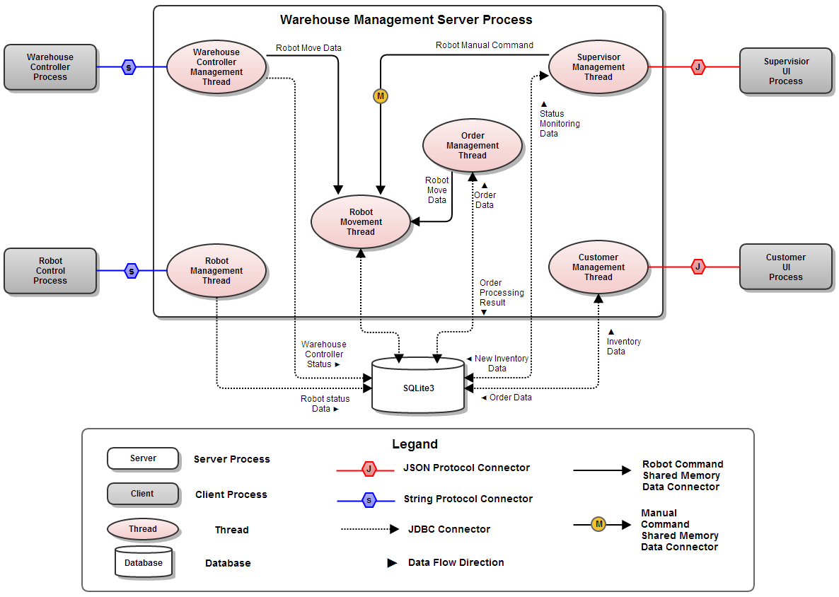
C&C View - Level 2 Decomposition

Slide 25
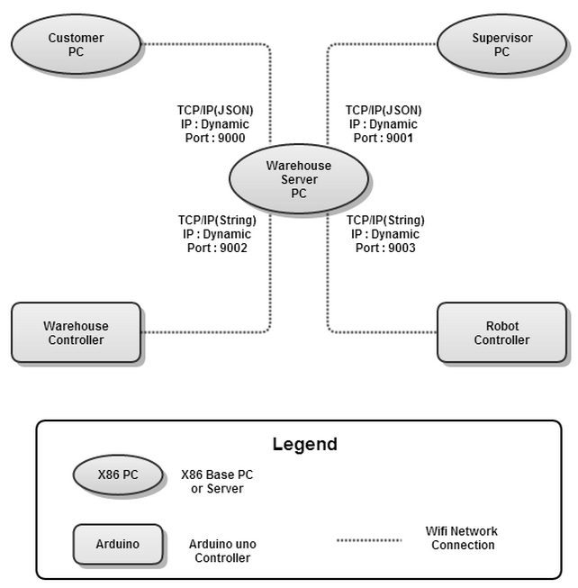
Allocation View – Overall Architecture (Level 1)
Notes:
어떤 환경에서 구동이 되는지 HW와 네트워크 인프라 관점에서 설명

Slide 26
Deliverable Artifacts – Source Code
Source code ( 87 Files, 13,771 LOC)
Program Type | Used Technology | Developer | Volume (LOC)
Customer UI | Java, Swing, JSON | Hyugjin Kwon | 1,834
Supervisor UI | Java, Swing, JSON | Hyugjin Kwon | 5,184
Warehouse Management Server | Java, JSON, Socket, SQLite | Dongju Kim, Heeseung Kim | 4,478
Robot Control | C, Arduino, Socket, Line trace | Kideok Kim | 1,301
Warehouse Controller | C, Arduino, Socket | Jonggon Kim | 974
Notes:
Customer의 관심이 Availability에 있기 때문에

Slide 27
Deliverable Artifacts – Documents
13 Documents, 280 pages
Doc Category | Document ID | Document Description | Pages
00. Presentation | [WMS_Presentation_001] | Initial Presentation | 28
 | [WMS_Presentation_002] | Final Presentation | 31
01. Analysis | [WMS_Analysis_001] | Inintal Analysis Document | 31
 | [WMS_Analysis_002] | Architectural Driver Document | 26
02. Interface | [WMS_Interface_001] | Protocol Design between Controller & Server | 13
 | [WMS_Interface_002] | Protocol Design between Robot & Server | 14
 | [WMS_Interface_003] | Protocol Design between Customer & Server | 12
 | [WMS_Interface_004] | Protocol Design between Supervisor & Server | 25
03. Design | [WMS_Design_001] | Notional Architecture Document | 26
 | [WMS_Design_002] | System Architecture Design Document | 36
04. Management | [WMS_Manage_001] | Project Plan and Management | 24
 | [WMS_Manage_002] | WBS & Individual Time Log | 11
05. Defect Management | [WMS_Testing_001] | Test Case & Result | 3
Notes:
Customer의 관심이 Availability에 있기 때문에

Slide 28
Lesson Learned – Project Management
Project plan
Plan should reflect reality, like “the weekly exams”.
Need more formal unit and integration test plan.
Plan needs to be modified after significant architectural decisions.
Project management(Earned Value Tracking)
It is very difficult to make a habit of recording in time log.
It’s good tool to track the project based on WBS.
It is easy to see the gap which leads to analysis of why the gap exists.

Slide 29
Lesson Learned – Architecture Design
Architecture Design
Scalable Design is not free!!
But, if it’s not considered in design ➔ more costly!! or does not scale
For satisfying multi robot and warehouse requirement, we have made:
Complex protocol design between server and clients
Complex database table design, User Interface, Control Logic
We spent a lot of time for readiness of modifiability
So, we could meet QA-01, “Modifiability : Warehouse management system
can be enlarged in physically”
Risk of late experimentation
Arduino WiFi capability experiments impacts architectural decision
We only focused on computing power & protocol testing
Discovered network connection management problem very late (3rd week)
In the middle of the project, it was very expensive to change the design

Slide 30
Future Needs
How would your design support scaling out to include more inventory stations within the same warehouse?
Already designed and implemented
How would your design support two robots in the same warehouse?
Already designed and implemented protocols, DB, UI for multiple robots
Need to confirm by testing with multiple robots
How would you have to change your system to support fulfilling a single order that was larger than the robot could hold?
Already considered in architecture. Algorithm should be modified a little
How would your design support a distributed inventory management?
Already designed to control multiple warehouses
Need to confirm by testing

Slide 31
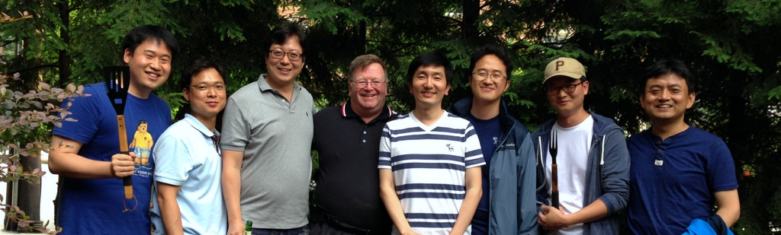

Q&A
We Are Lucky Guys!!!

Slide 32
Appendix - Quality Attribute Utility Tree
QA ID | Modifiability | Priority | Difficulty
QA-01 | Warehouse management system can be enlarged in physically | M | M
QA-02 | Fulfilling an order which Robot cannot handle at once. | L | L
QA ID | Performance | Priority | Difficulty
QA-05 | The system should able to complete within a required time from customer order | L | M
QA ID | Security | Priority | Difficulty
QA-10 | Unauthorized Supervisor accesses should not be allowed. | L | H
QA ID | Availability | Priority | Difficulty
QA-03 | If robot's IR sensor was broken, error status can be monitored in management system | M | M
QA-04 | Loss of WIFI Communication between robot and server can be detected and recovered in time | H | M
QA-06 | Loss of WIFI Communication between server and warehouse controller can be detected and recovered in time | H | M
QA-07 | If robot’s don’t move because of battery is too low, robot status can be monitored in management system | L | H

Slide 33
Appendix – Dynamic Behavior
How interact runtime element for order process

Slide 34
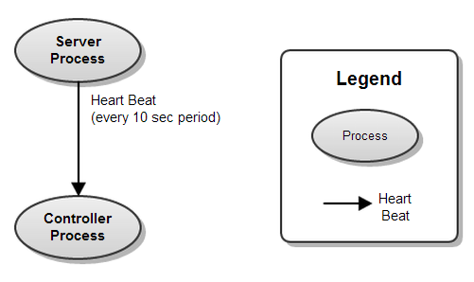
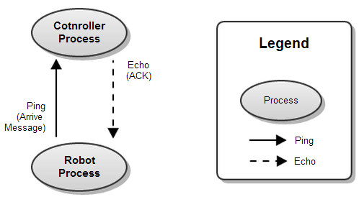
Appendix - Ping-Echo vs Heart beat
Why using Ping-Echo
Can be stress to Arduino
using more computation power
Keeping network connection is hard
(Arduino 1.0.4 WiFi library problem)
High accuracy
VS
Low computing power & Traffic
using less computation power
Server can know disconnect by Socket
Robot can know disconnect when using
Low accuracy (on demand)

Slide 35
Appendix – Strength & Weakness of Candiate
 | #1 Centralized | #2 Controller Mediator
S | Easy to manage the system status, because the status information of each sub-system is gathered in the central server Easy to detect the error status of each sub-system Need not care about the computational power of warehouse controller | This architecture has more advantage over modifiability (Scalability, Maintainability) Resource load balancing of computational power in the WMS is possible Human resource allocation for each sub-system is much Easier Server can have less complexity comparing to server centric architecture. Server can be decoupled with robot, which results in earning more cohesion. Server need not to be in same network area with the robot. network and computational overhead can be reduced through sending sensor signal from warehouse control system to the robot directly
W | The scalability is inhibited by increased dependency of the warehouse management server The modularity is inhibited by heavy functionality of the warehouse management server The system resource of warehouse management system might be wasted by un-needed periodic status checking | If warehouse control system is broken, server can not monitor robot's status. If warehouse control system is broken, server can not control robot. The Warehouse control system's performance experiment is required.

Slide 36
Appendix – Quality Assurance
Final Test Result (2014-06-27)
Test Type | Test Case # | Pass # | Pass Rate
Unit Test | 55 | 55 | 100%
Integration Test | 34 | 34 | 100%
System Test | 8 | 8 | 100%

